Slide 1
PRIME SYNTHETICS
Developed By:- 1) Aditya Khatri – 241029
2) Rajal Sarvaliya – 241093
3) Palak Chakrani - 241008

Slide 2
PROJECT DEFINATION
This project is an E-Commerce shopping website made using the MERN stack ( React.js, Node.js, SQL).
to log in, browse products, place orders, and make payments online. The admin can manage products, categories, and orders
We specialize in high-quality non-woven fabrics for medical, hygiene, garment, airline, and packaging applications. Our products include spun bond fabrics, specially treated materials, and disposable medical and sanitary items.
Designed for performance, safety, and sustainability across diverse industries.It allows users.

Slide 3
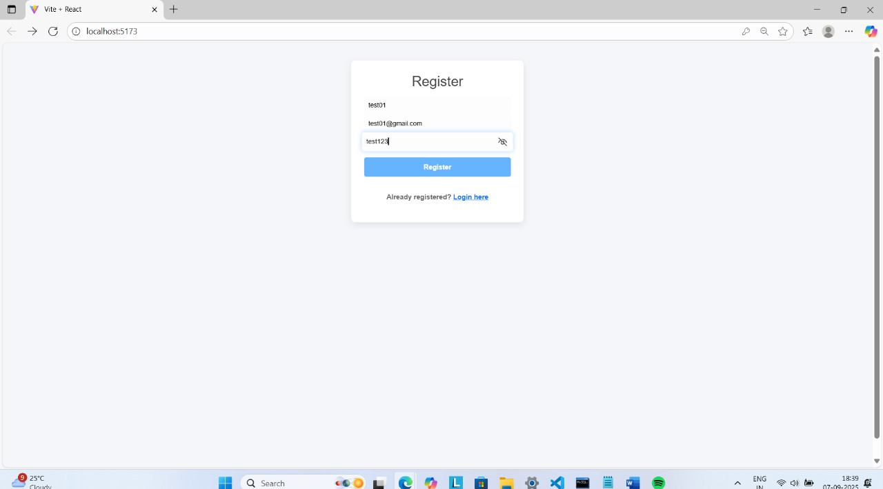
System Design & Database Development
Registration Page

Slide 4
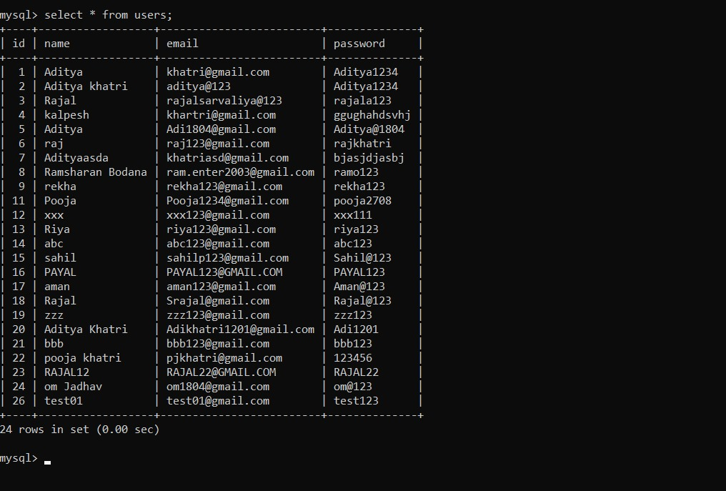
System Design & Database Development
Registration data

Slide 5
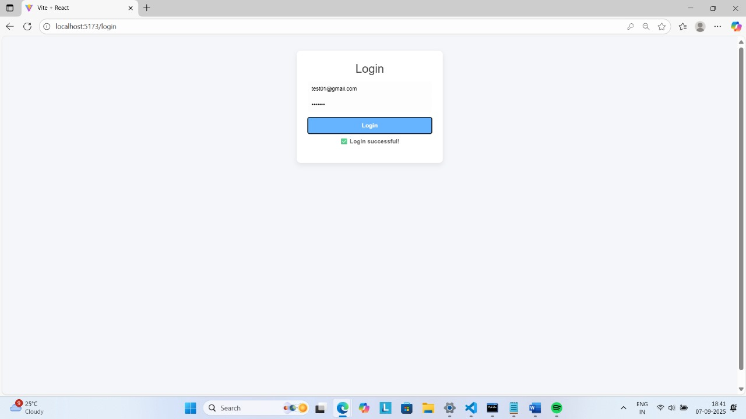
Login Page

Slide 6
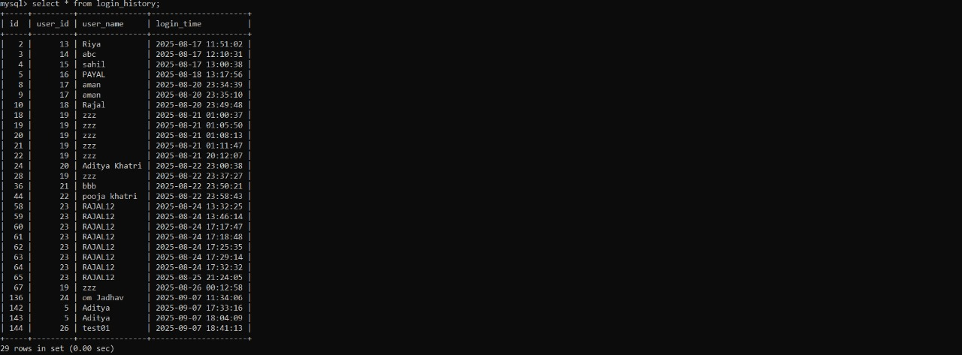
System Design & Database Development
Login data

Slide 7
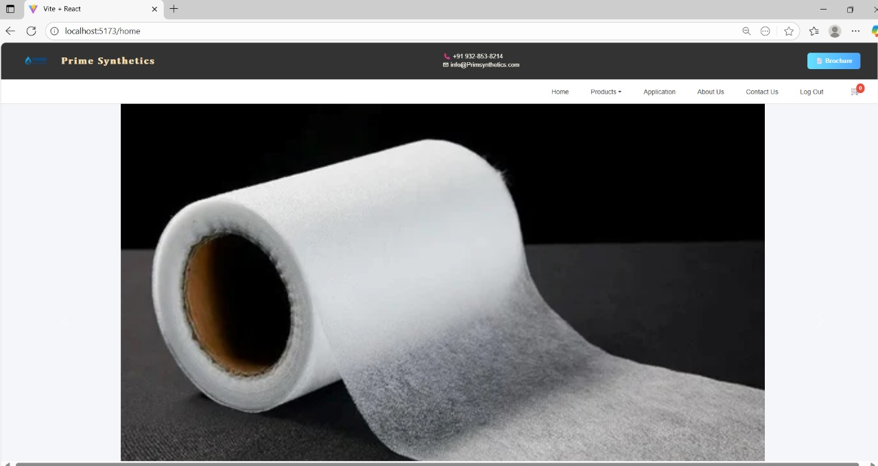
Home Page

Slide 8
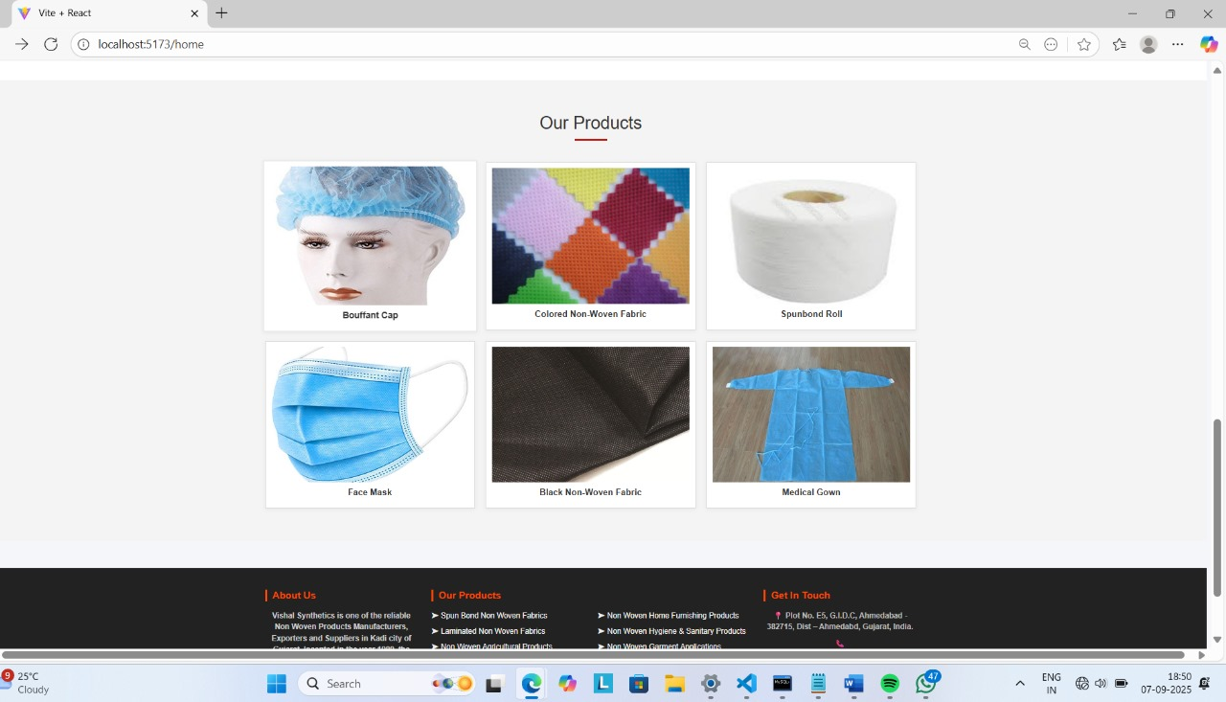
Product Page

Slide 9
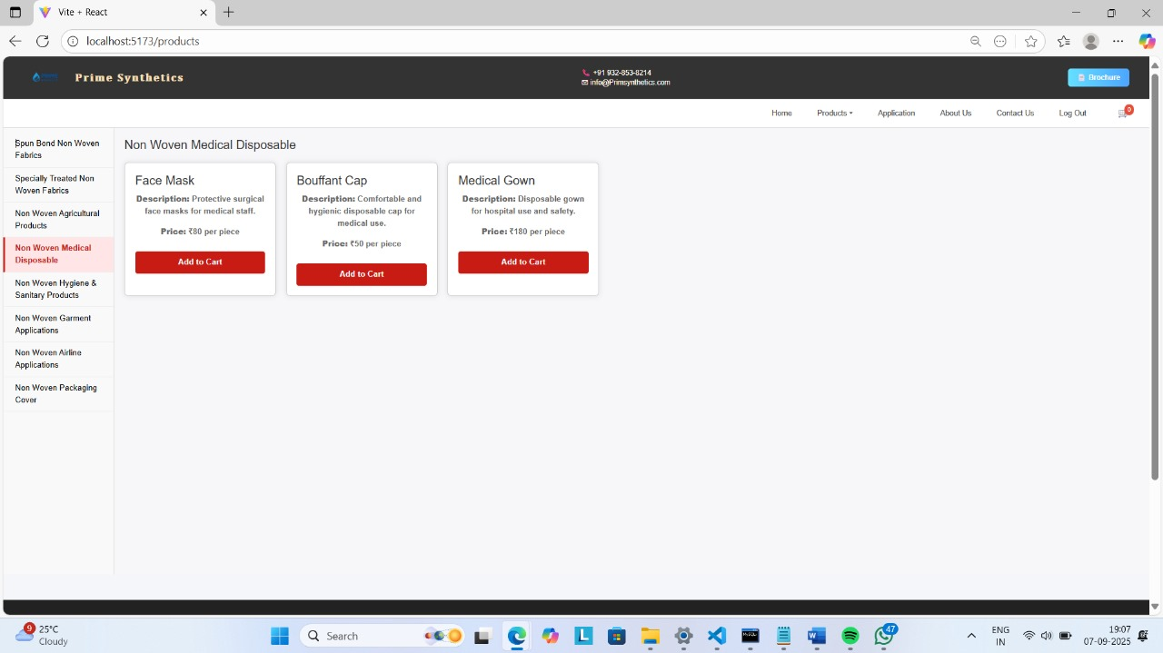

Slide 10
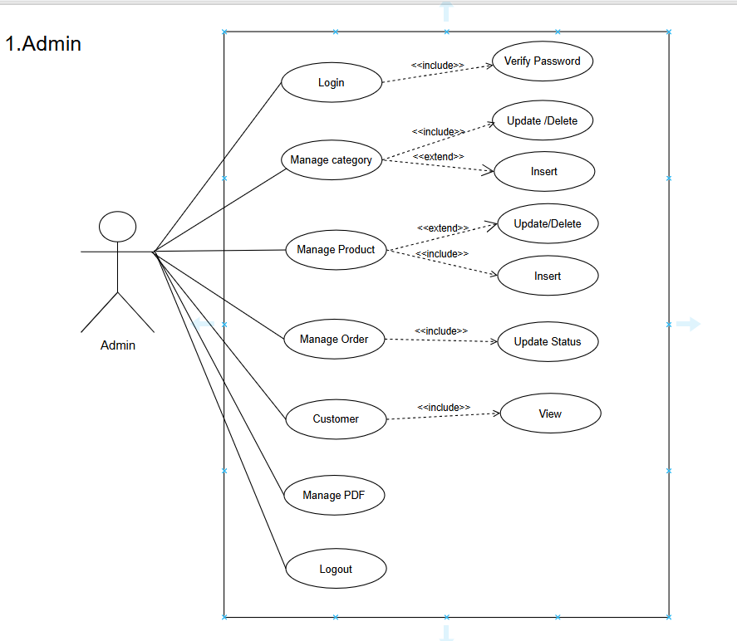

Slide 11
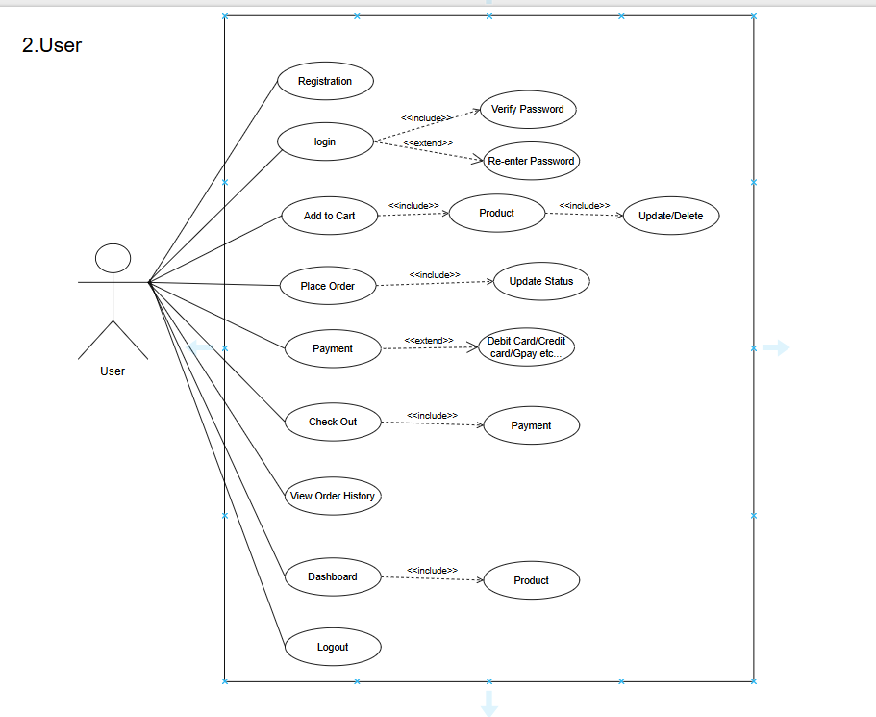

Slide 12
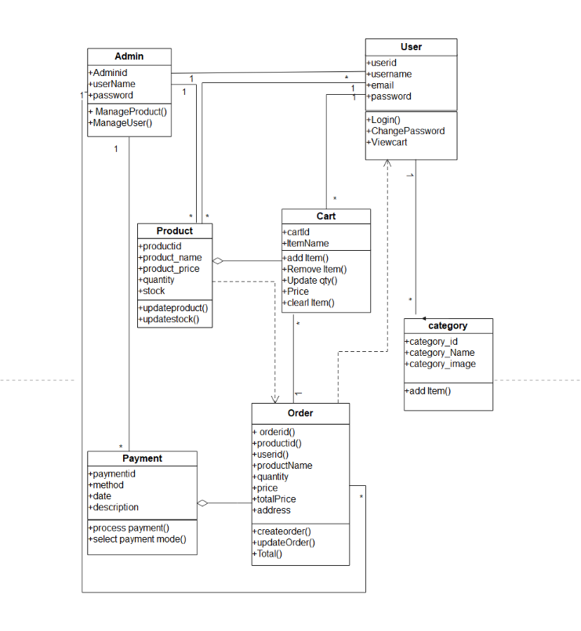
Class Diagram

Slide 13
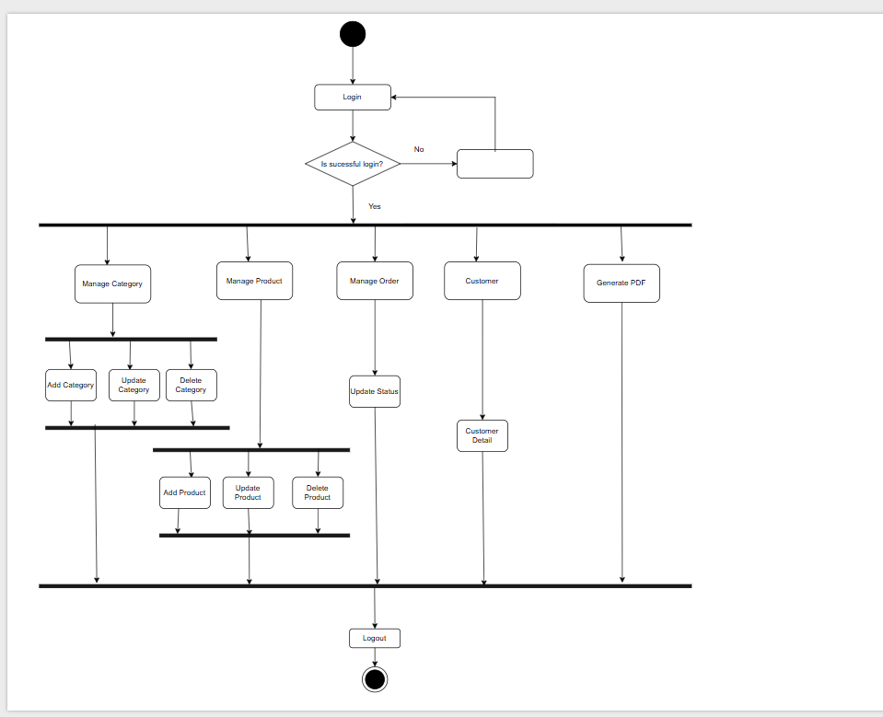
Activity Diagram(Admin)

Slide 14
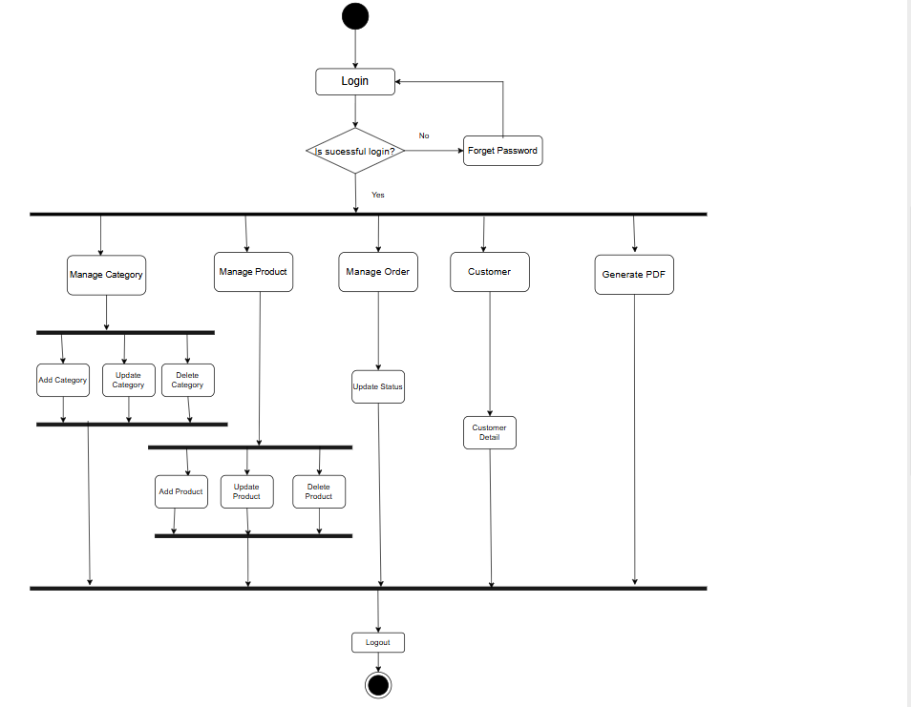
Activity Diagram(User)

Slide 15
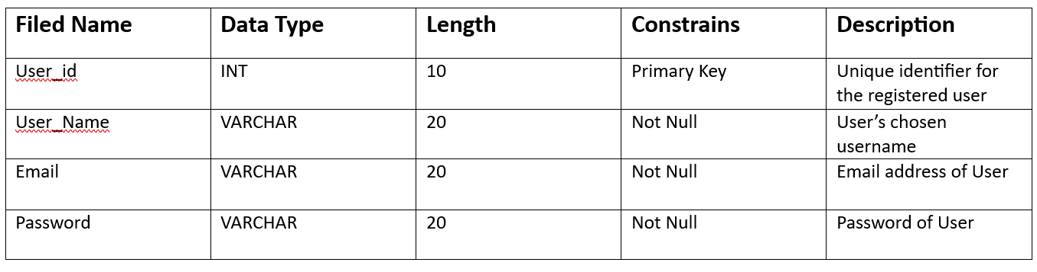
Data Dictionary
User Table

Slide 16
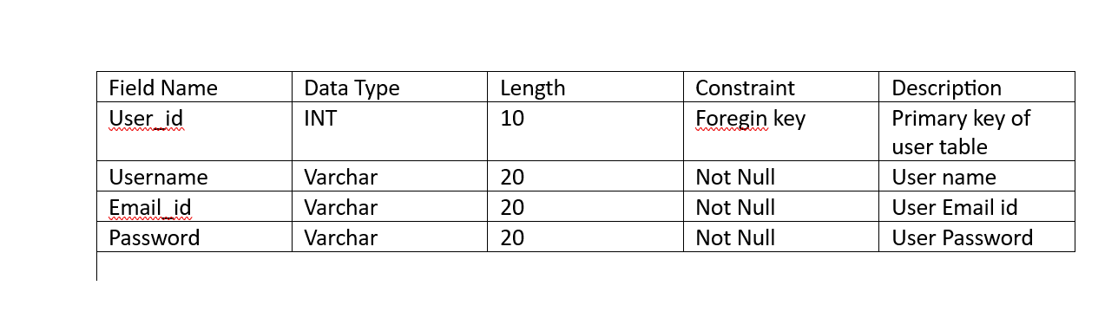
Login Table

Slide 17
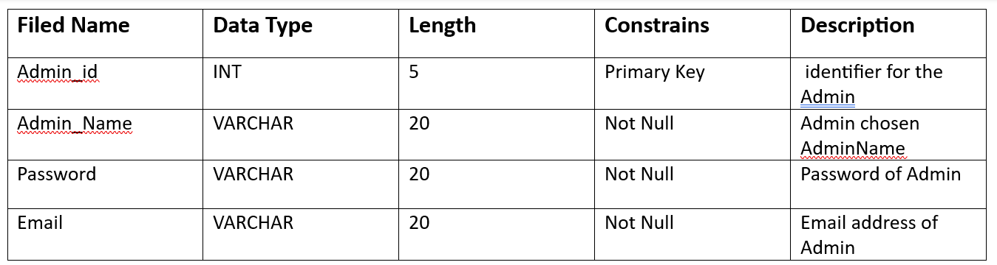
Admin Table

Slide 18
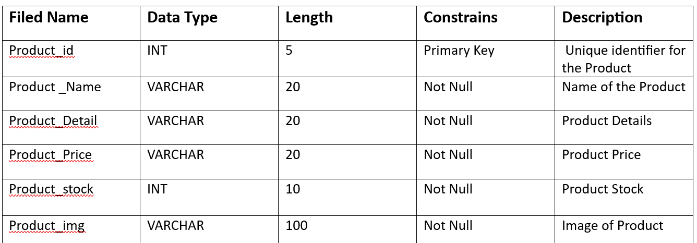
Product Table

Slide 19
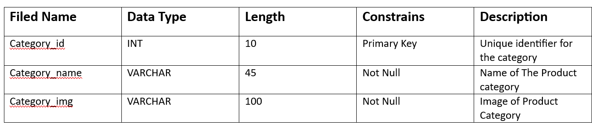
Category Table

Slide 20
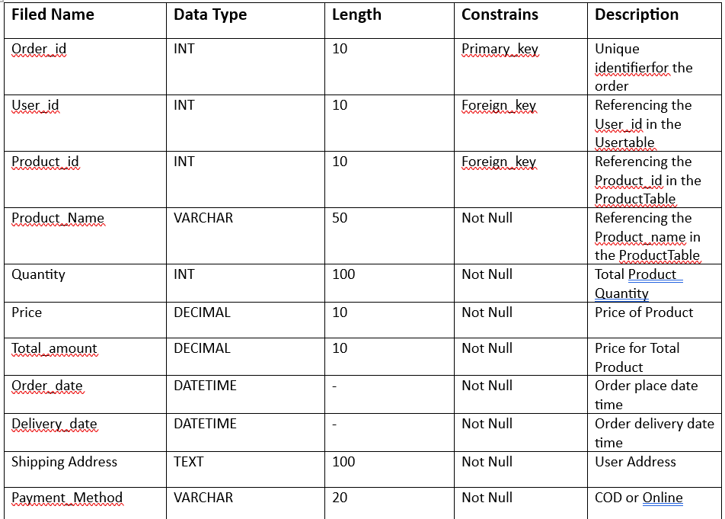
order Table

Slide 21
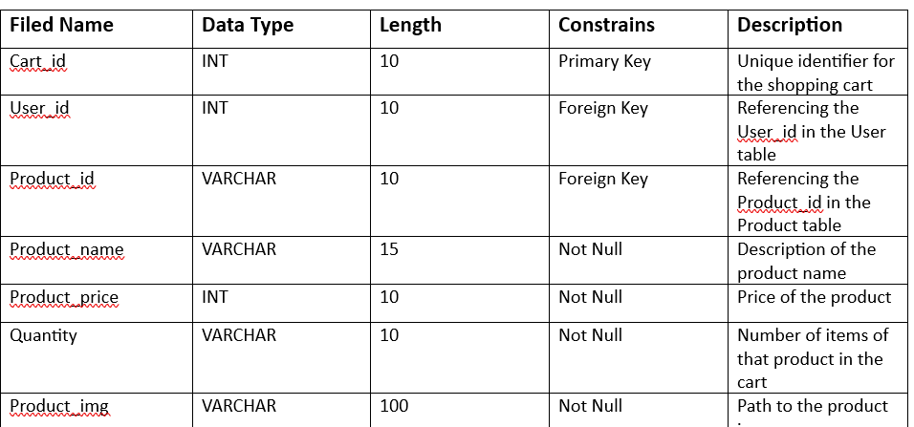
cart Table

Slide 22
Thank You For Your Attention
……

